Slide 1


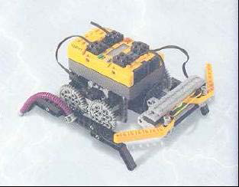
UNCLASSIFIED
Presented to:
Professor Bonnie Young
Customer
Advanced Counter IED Detection System (ACIDS) System Suitability Assessment
Presented by:
ACIDS Engineering and Suitability (ACES) Team
Steve Mazza Kimberly Battle Maranatha Zopfi Michael Oexman Donna Ray
2 Dec 2011
UNCLASSIFIED

Slide 2

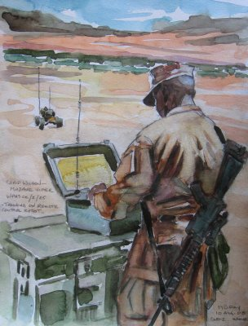
Problem Background
Improvised Explosive Devices (IEDs) have been and continue to be a serious threat to military forces and to civilian populations in theater.
Countering IED has been limited to route clearance and minimal to area clearance
Effective Need
Customer has a need for a system that can provide area clearance of IEDs for military forces and civilian populations. The proposed Micro Expeditionary Transforming Air Land Vehicle (METAL-V) system will need feasibility analysis for development and production suitability.
Requirements
The following KPPs have been established for ACIDS: KPPs | Threshold | Objective
Mission Reliability (DRM) | 0.90 | 0.95
Operational Availability | 0.80 | 0.90
DRM Elapsed Time | 5 minutes | 3 minutes
Deployed-to-Ready Time | 10 minutes | 5 minutes
Operational Team Size | 2 people | 1 person

Slide 3
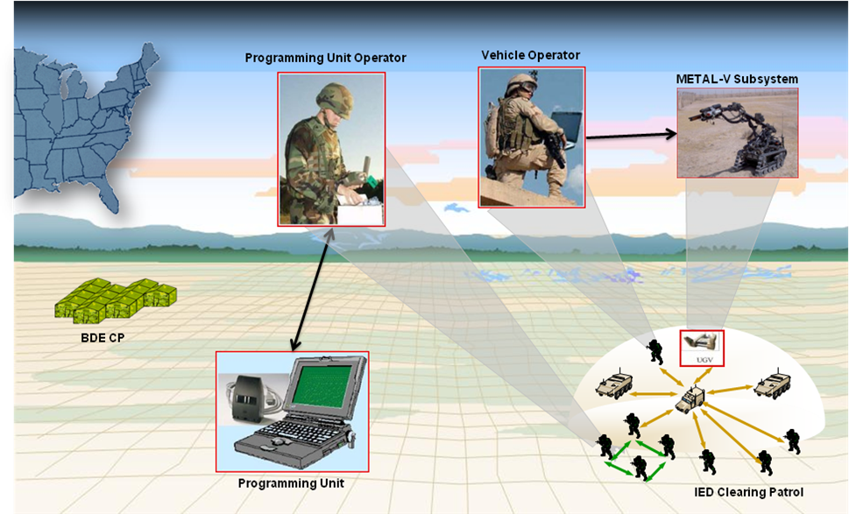
ACIDS System Concept
Operational View (OV-1)
Vehicle Operator
Programming Unit Operator
Metal-V Subsystem
Programming Unit
ACIDS Diagnostic Subsystem

Slide 4
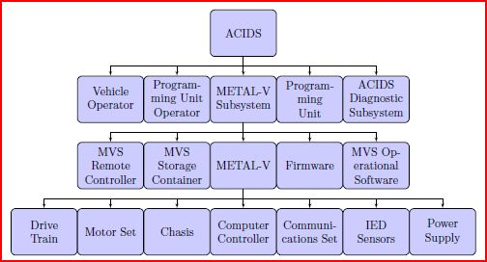
ACIDS Functional Hierarchy
Assessment Focused on the Metal-V Subsystem

Slide 5

Reliability
Completed Reliability Analysis of the top level METAL-V components
Mission Reliability KPP of 90% can be achieved given the above allocations
Recommend Redundant IED Sensors
Reduced the MTBF for non IED-Sensor components

Slide 6
Operational Availability (Ao)
Evaluated using
{Mean Time Between Maintenance (MTBM), Uptime}
{Maintenance Downtime (MDT)+MTBM, Downtime}
MTBM=49hrs
MDT=13hrs
Total Ao= 17.7% < 80% Threshold KPP
Recommendations
Decrease maintenance action through evaluation of doctrine, organization, training, material, leadership, personnel, and facilities (DOTMLPF)
Increase MTBM

Slide 7
Software Suitability
Software Criteria
Correctness
"Each system requirement shall be supported directly by one or more calls, methods, procedures, components, classes, or libraries of the METAL-V operational software which shall map directly to and support system requirements."
Reliability
"The METAL-V operational software shall perform consistently as written under normal operating conditions with a reliability greater than 0.98."
Usability
"The METAL-V operational software shall present an interface that closely resembles the physical operation of the system."
"The METAL-V operational software shall prevent over rotation of the number six servo."

Slide 8
Evaluation
ACIDS system has potential to provide better support than the current dismount of scouts to conduct reconnaissance with their vehicles
High Level of Physical Architecture has been laid out with reliability values
Achievable Reliability KPP
Operational Availability KPP requires action
Less than Threshold Value for Subsystems
Significant dependency on Lego Mindstorm NXT brick
Current assessment provides early feedback on system viability, user adoption, and lessons learned.
The current of the overall ACIDS prototype software is not suitable for acceptance and lifecycle use

Slide 9
Recommendations and Future Analysis
Remain in Concept Design Phase
Complete Overall System Functionality Review
Current Assessment only Focused on Searching for IEDs
Detection is key and not included in this assessment.
Further analysis of ACIDS software suitability, traceability, and flexibility necessary.
COTS software integration has not been established
Successful analysis of functionality and software areas of design would aid in determining overall system suitability of ACIDS

Slide 10
Questions and References
Questions
References
Blanchard and Fabricky, Systems Engineering and Analysis 5th Edition, Prentice Hall (2010)
Rechtin and Maier, The Art of Systems Architecting Second Edition, CRC Press LLC, 2002
Presentation: SE 3302 Project Description Background, Bonnie Young, Naval Post Graduate School Fundamentals of Systems Engineering, 2011

